Slide 1
Costume and Fashion Design
Finding Design Inspiration

Slide 2
What is the Design Process?
Analysis
Design Collaboration
Research
Preliminary Sketches (Thumbnail Sketches)
Final Sketches
Finished Swatched Rendering

Slide 3
Design Originality
As a designer, your designs should be your originals not copies of another designer’s work. Being inspired by another designer’s work is fine. You should take the ideas that have inspired you and translate them and interpret them with your own originality.
Using a theme or unusual concept exercise can be helpful in stimulating new ways to look at your designs.
While the outcome of these design exercises may not be practical in your realized designs, they can inspire you to add elements and principles of design which you may not have considered.

Slide 4
Ideas For Finding Inspiration
Technology
Art
Food
History
Architecture
Nature

Slide 5
Technology

Slide 6
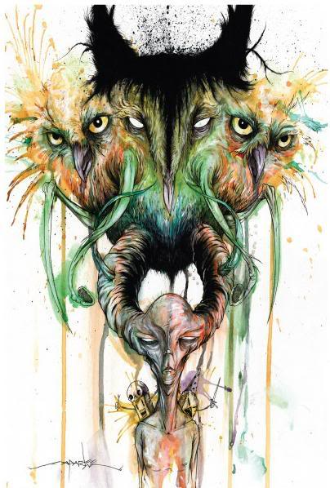
Art
Owlex by Alex Pardee

Slide 7
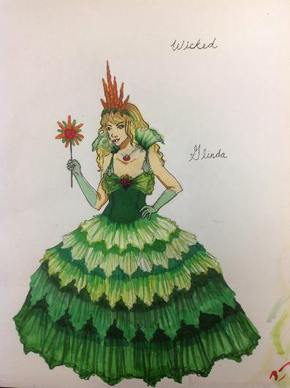
Food

Slide 8
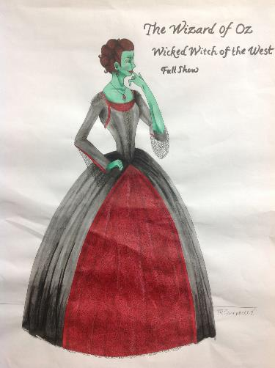
History

Slide 9
Architecture

Slide 10
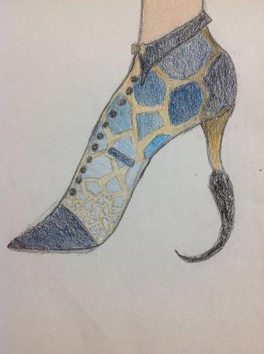
Nature

Slide 11
Using the Elements of Design to create an effective Design

Slide 12
What are the Elements of Design?
Color
Form
Line
Shape
Space
Texture
Value

Slide 20
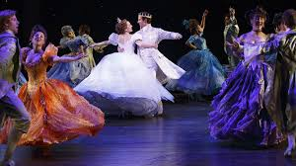

Slide 21
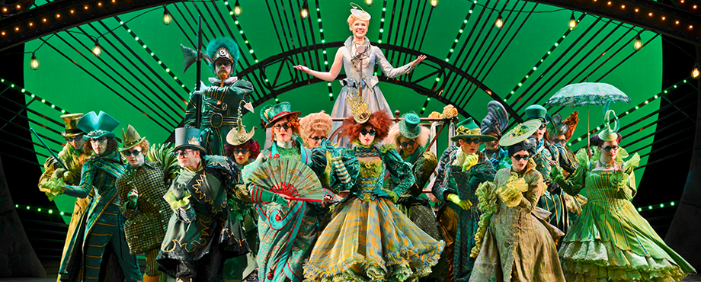

Slide 22
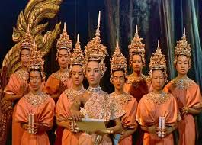

Slide 23
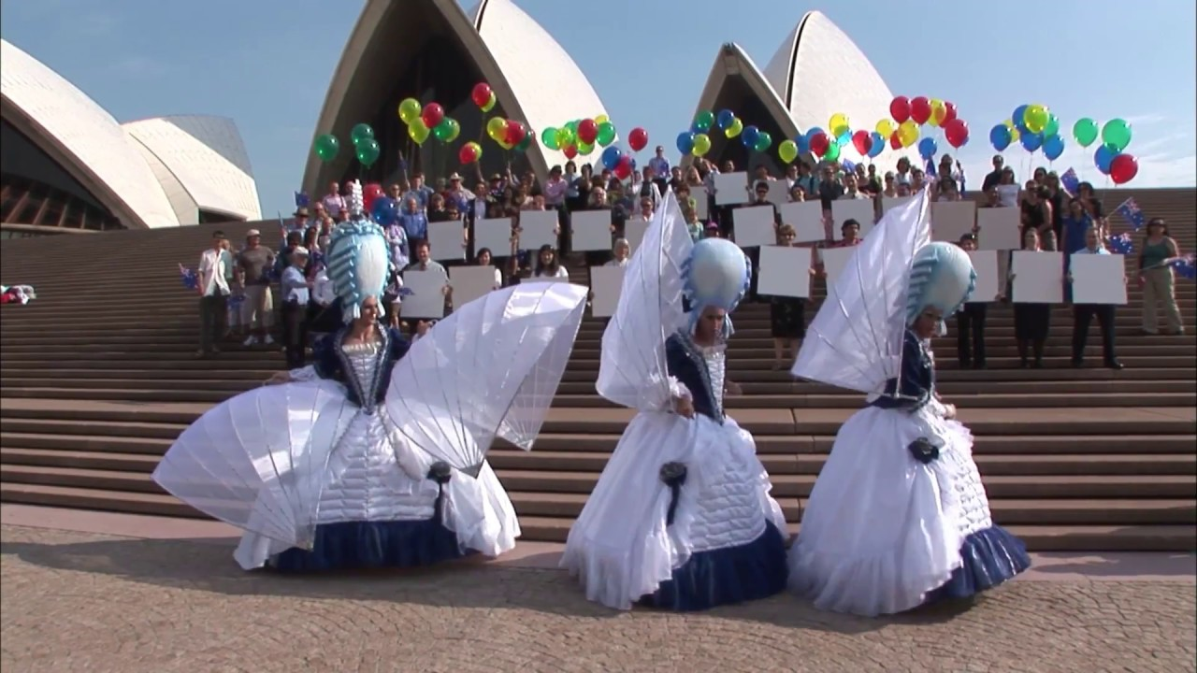

Slide 24
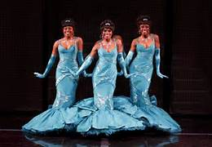

Slide 25
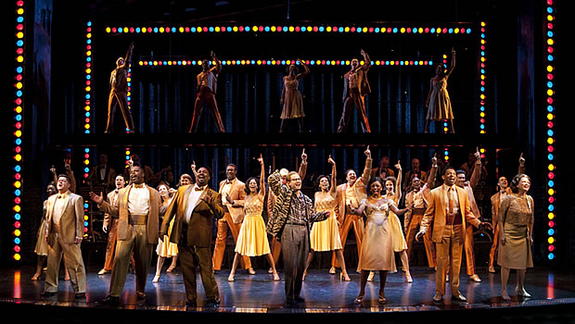

Slide 26
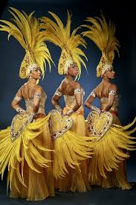

Slide 27
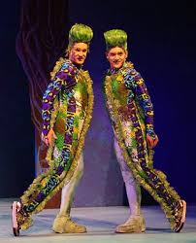
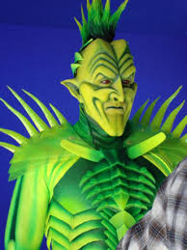

Slide 28
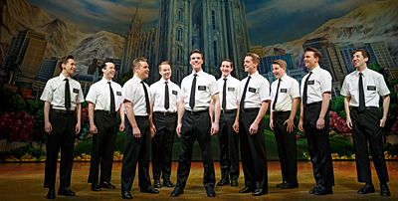

Slide 29
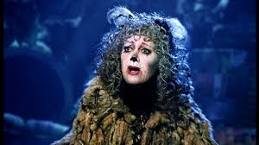
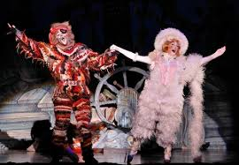

Slide 30
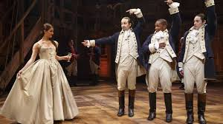

Slide 31
What Are Ways to Create a Color Rendering?
Watercolor
Markers
Color Pencils
Collage

Slide 32
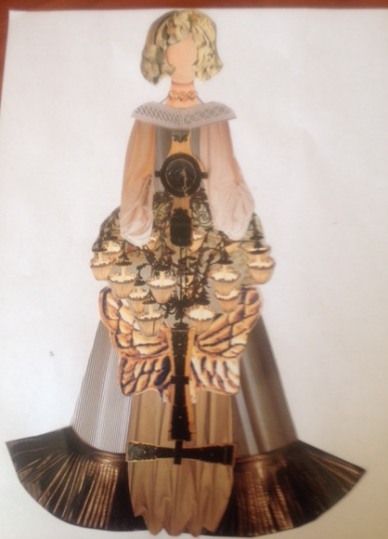

Slide 33
Completed Costume Rendering

Slide 34
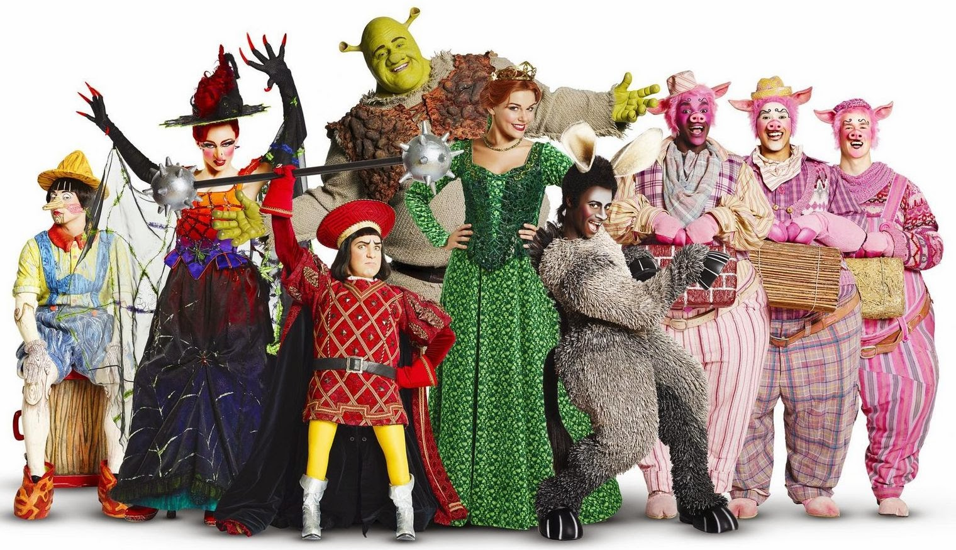

Slide 35
Methods for Figure Drawing
Correct Proportions

Slide 36
Drawing the Human Figure

Slide 37
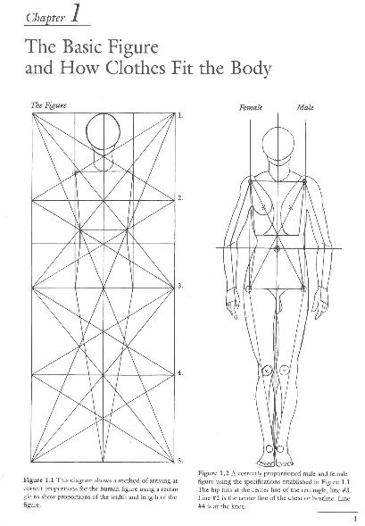

Slide 38
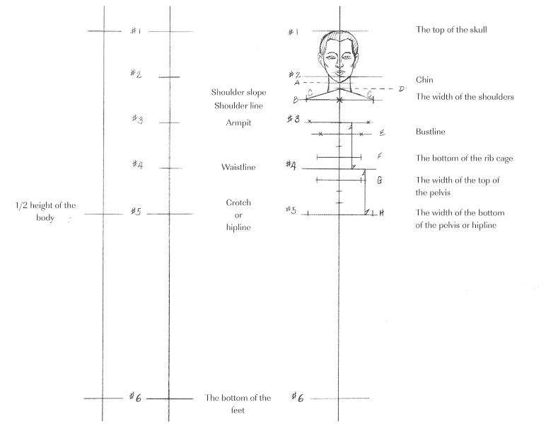

Slide 39
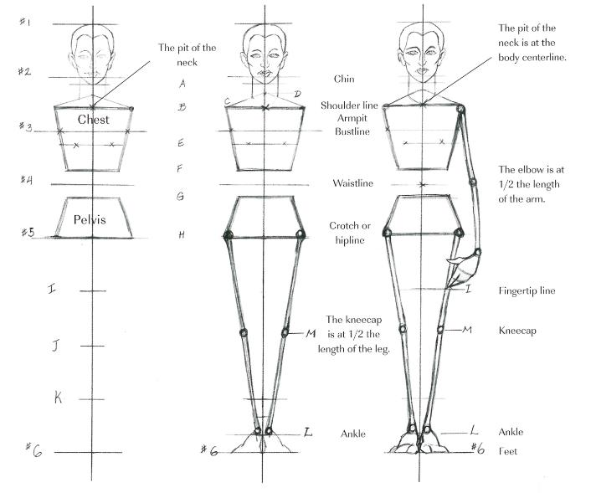

Slide 40
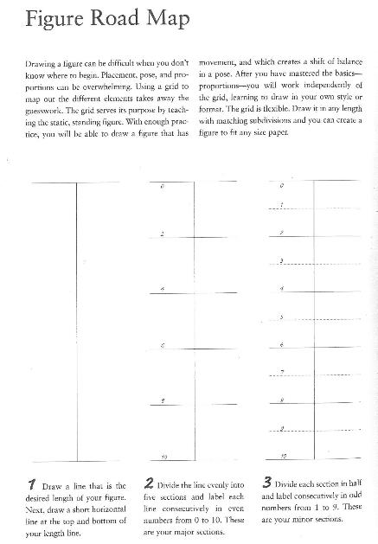

Slide 41
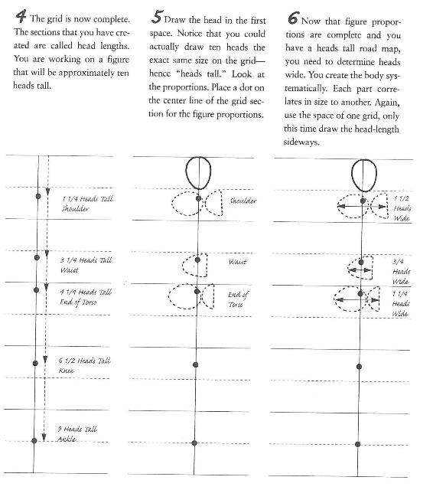

Slide 42
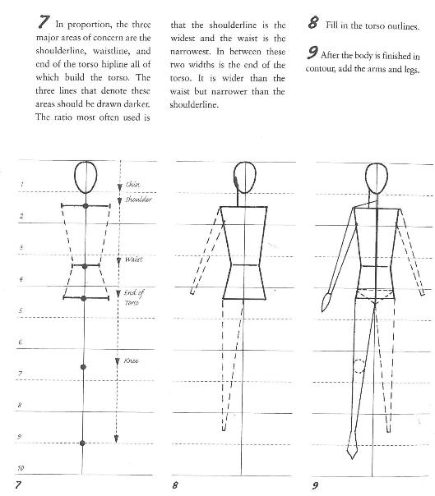

Slide 43
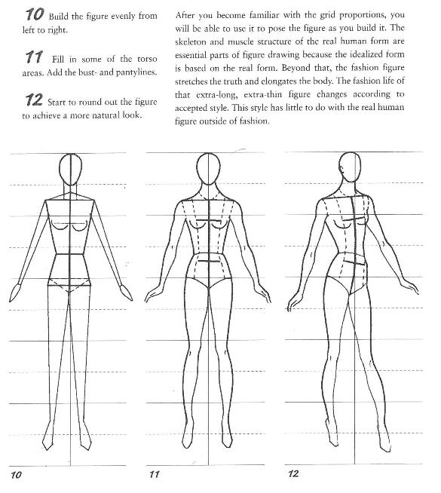

Slide 44
Sources
https://www.slideshare.net/emurfield/elements-principles-of-art-design-powerpoint
https://nlbarn.org/2016/06/16/the-production-process-for-shrek-the-musical/
https://i.pinimg.com/736x/2f/42/da/2f42da5458759a2a7b3f97fd23a35562--costume-wigs-movie-costumes.jpg
https://i.ytimg.com/vi/yP6LcQ8AVJM/maxresdefault.jpg
https://thefairytaleemporium.files.wordpress.com/2014/09/img_0516.png
https://i.pinimg.com/originals/b1/29/58/b12958fe2ff885347c8f8d8d2bd64648.jpg
http://1.bp.blogspot.com/-4eghHQtc0dM/UWb4jz57NfI/AAAAAAAAEa0/84MmzLvDIqU/s1600/Cinderella2294+Laura+Osnes,+Santino+Fontana+and+the+ensemble+of.Cinderella.jpg
http://www.lasplash.com/uploads//5/memphis_cast-2.jpg
https://i.pinimg.com/originals/91/c2/d0/91c2d0bbea13ccd83208a2f285dad62b.jpg
http://www.costumearmour.com/images/customdesign/gg0.JPG
https://berkshireonstage.files.wordpress.com/2015/02/boshamilton-marcus1.jpg?w=700&h=467
https://chitownstarconnections.files.wordpress.com/2012/05/cats-009.jpg
https://www-tc.pbs.org/wnet/gperf/files/2014/11/mezzanine_643.jpg
https://www.vancouverpresents.com/wp-content/uploads/2015/04/book-mormon-cast-696x348.jpg

Slide 45
Baker, Georgia. Handbook of costume drawing: a guide to drawing the period figure for costume design students. Place of publication not identified, Focal, 2013.pg.1
Abling, Bina. Fashion Sketchbook.Place of publicaiton not identified, Fairchild Books & Visuals; 3rd Sprl edition, 1999. pgs.11-15
Huaixiang,Tan. Character Costume Figure Drawing: Step-by-Step Drawing Methods for Theatre Costume Designers 2nd Edition, Burlington, Focal Press, 2013. pgs

